Slide 1

Big Mountain Resort Ticket Pricing
Prepared by: Vandana Anand

Slide 2
Problem Identification
Recently experienced increased operational costs due to a new ski lift being installed.
There are doubts that the current pricing of the tickets does not reflect the value of the facilities offered.
Goal:
Management would like to update the pricing model of the resort to take a more data driven approach.
Additionally, management would like to decrease operating costs.

Slide 3
Recommendations & Key Findings
Big Mountain should increase their ticket price to $85.50 which is $4.50 more than the current ticket price.
Adding an additional ski lift along with increasing the vertical drop by 150 ft and adding an additional run would increase the ticket price by an additional $1.99.
If a new ski lift is added, closing 2 of the least used runs would not result in a decrease of ticket price and would save on operation costs.
These changes would lead to a ticket price of $87.50 after rounding, which is a total of $6.50 more than the current price.
As the expected number of visitors over the season is 350,000 and, on average, visitors ski for five days, this would indicate a season revenue increase of $11,375,000. As the additional ski lift increases operation costs by $1,540,000, this would mean additional profits of $9,835,000.

Slide 4
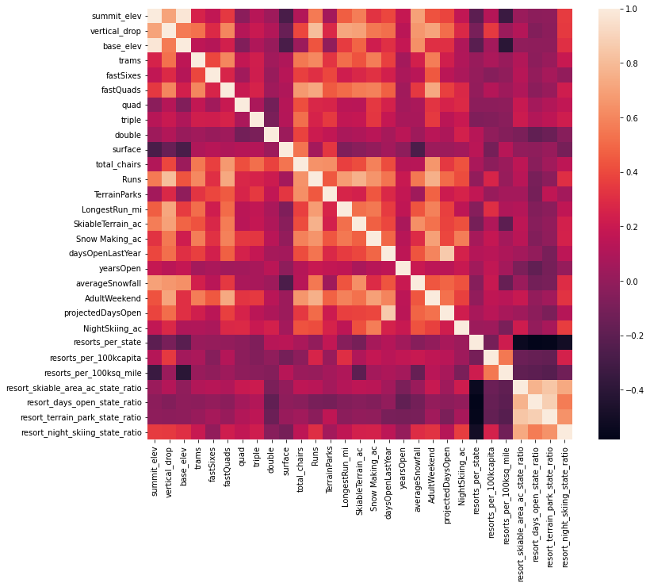
Modeling Results & Analysis
As there were a total of 27 attributes in the provided data, it was important to determine which attributes had higher effect on the ticket price than others.
In order to do this, I created a heat map which indicates the correlation between attributes to determine the key attributes.
Noted that the following features are significant to further analysis as they are highly correlated with ticket price: vertical drops, fastQuads, runs, total chairs, snowmaking_ac.

Slide 5
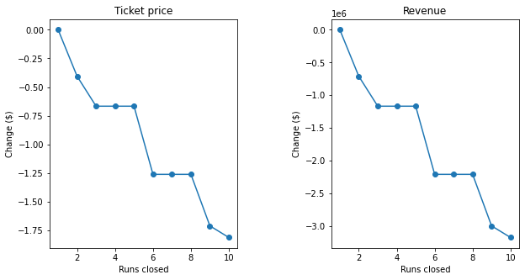
Modeling Results & Analysis
Created a model to predict ticket prices:
Determined the Big Mountain Resort modelled price is $95.87 with an expected mean absolute error of $10.39, while the actual price is $81.00.
Used the model to predict the result of 4 scenarios:
The first scenario predicted the change in ticket price if they should close up to 10 of the least used runs.
Noted that closing 1 run makes no difference, however closing 2-3 runs decreased the price, but at that point closing an additional 1-2 runs will not change the price. Once you close 6 runs, the price drops significantly.

Slide 6
Modeling Results & Analysis
2nd Scenario:
This scenario predicts the change in ticket price if Big Mountain adds a run, increases the vertical drop by 150 feet, and installs an additional chair lift.
This scenario increases support for ticket price by $1.99.
3rd Scenario
This is the same as Scenario 2 with an addition of adding 2 acres of snow making.
Noted that this made no difference and still showed an increase in ticket price by $1.99.
4th Scenario
Scenario 4 shows the effect of increasing the longest run by .2 miles and guaranteeing its snow coverage by adding 4 acres of snow making capability.
This scenario showed no difference as well.

Slide 7
Summary & Conclusion
Based on the analysis done, Big Mountain Resort can increase their profits by nearly $10 million by making a few changes.
Additional details on the other current operating costs and details on the cost to implement each change would be beneficial to further assist with making decisions.
As it may be difficult to implement a drastic price increase all at once, business may choose to gradually change the price.
We will provide Big Mountain Resort access to the model so that you can use it in order to test scenarios and assist with decision making in the future.

Slide 8
Thank you!

